Slide 1
Software Engineering
Giảng viên:TS. Trương Anh Hoàng

Slide 2

Group5.K57CA’s Project

Slide 3
Members
Nguyễn Thạc Thống (Leader)
Phan Duy Thành
Bùi Đình Thành
Nguyễn Đức Thịnh
Ngô Văn Thiện
Phí Thị Thu

Slide 4
Description
https://github.com/zatcsc/group5.k57ca/wiki
Hanoi Easy Traffic is a web-based application to help people travel easily in such a crowed city as Hanoi, this application provides signed-in users services as follows:
View the traffic map of Hanoi
Find the routes with users’ original place and destination
Be updated traffic and weather information
Subscribe to the current traffic and weather condition
Provide and share the traffic data (optional)

Slide 5
Technology
Languages & Frameworks:
Ruby on Rails
HTML/CSS
JavaScript
2. Project management tools:
Github: https://github.com/zatcsc/group5.k57ca
PivotalTracker:
https://www.pivotaltracker.com/s/projects/1031610

Slide 6
Expectation
Finish the application’s basic functions
Learn about languages and frameworks to do a software engineering project
Achieve basic knowledge about Software Engineering: Agile Software Development, The Scrum Process, SEMAT

Slide 7
User Stories
Done user stories
Welcome page
View Hanoi page
Search the location
Find the route
View weather information
Contribute the current traffic information to the website
Current user stories
Create Contact page
View current location

Slide 8
Planning
Duration
Start date: 04/3/2014
End date: 20/5/2014
Weekly SCRUM:
Online: Skype, Facebook
Offline: Thursday afternoon

Slide 9
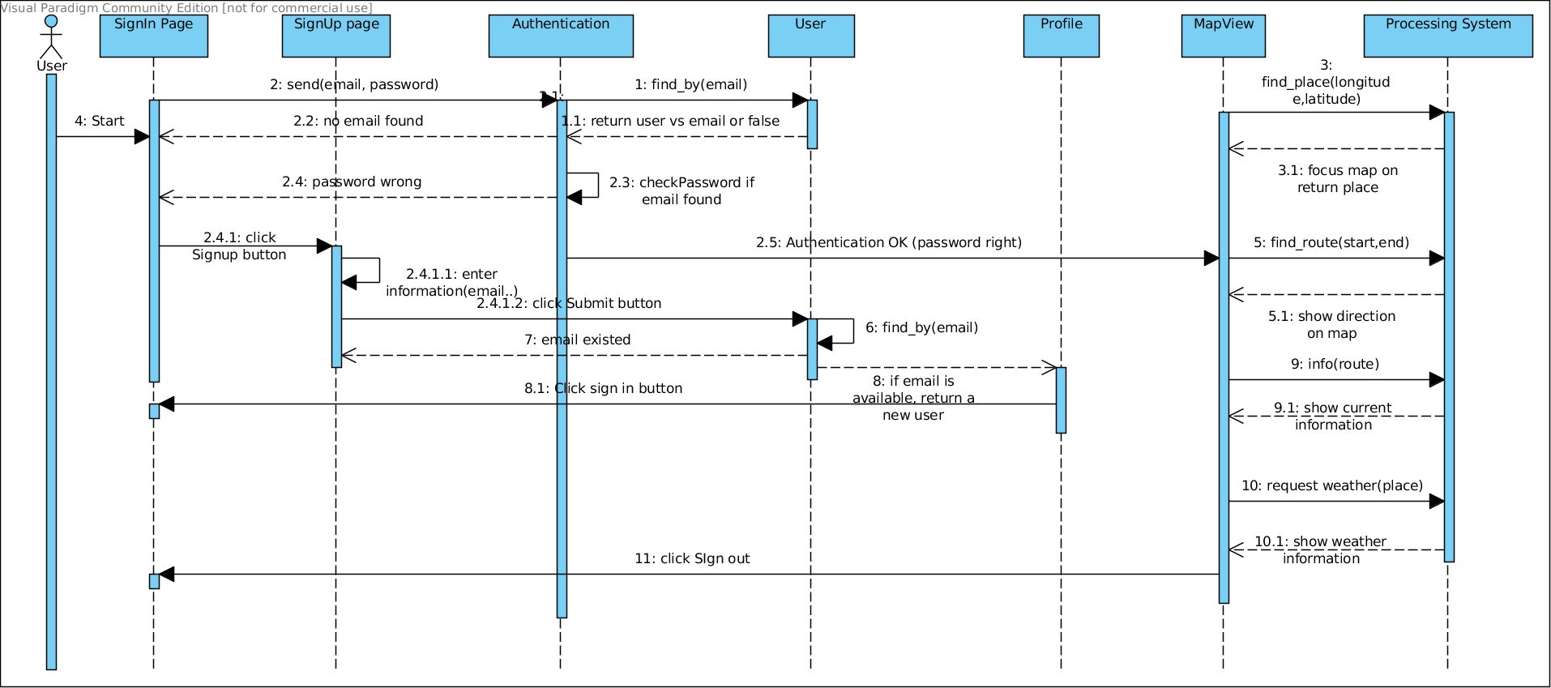
UML Diagram
Sequence Diagram

Slide 10

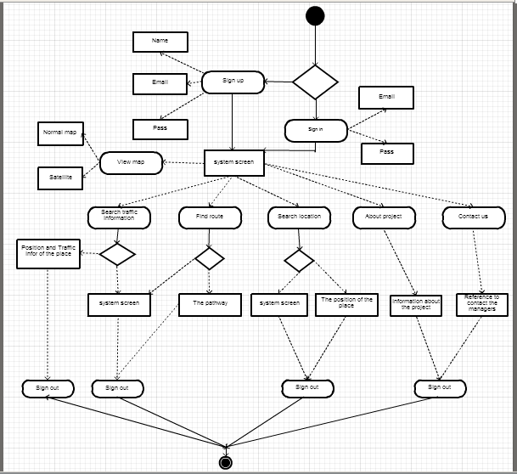
Activity Diagram

Slide 11

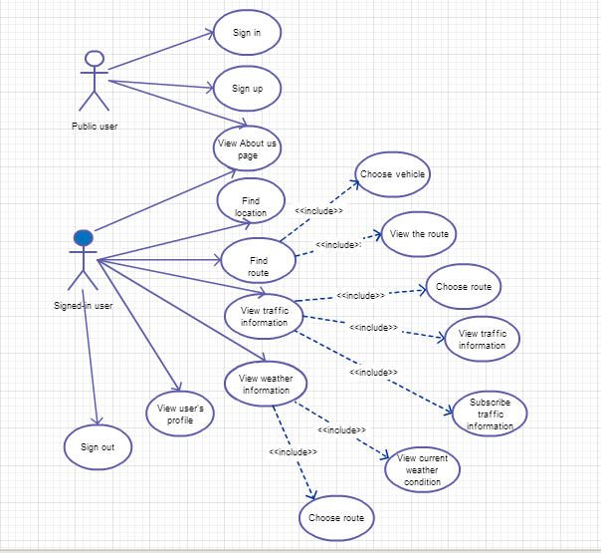
Use case Diagram

Slide 12
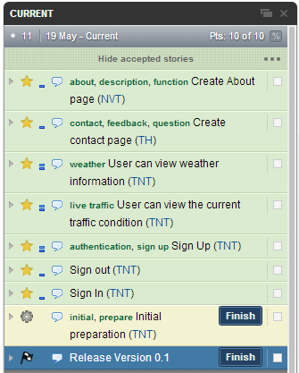
Pivotal Tracker

Slide 13
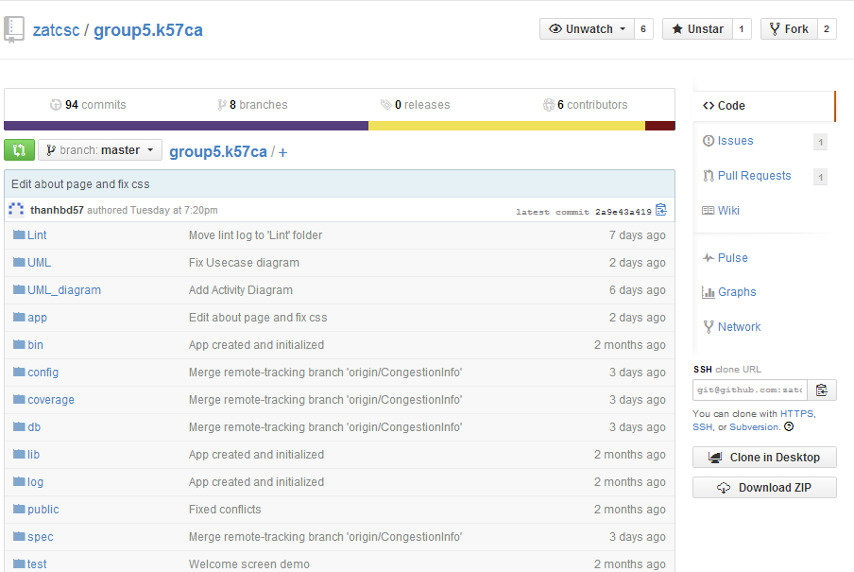
GITHUB

Slide 14
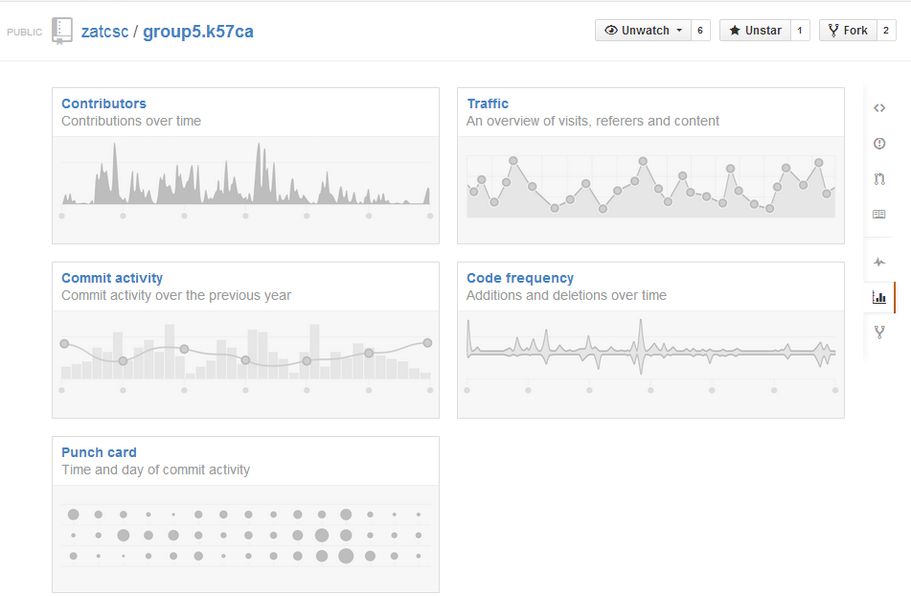
STATISTICS

Slide 15
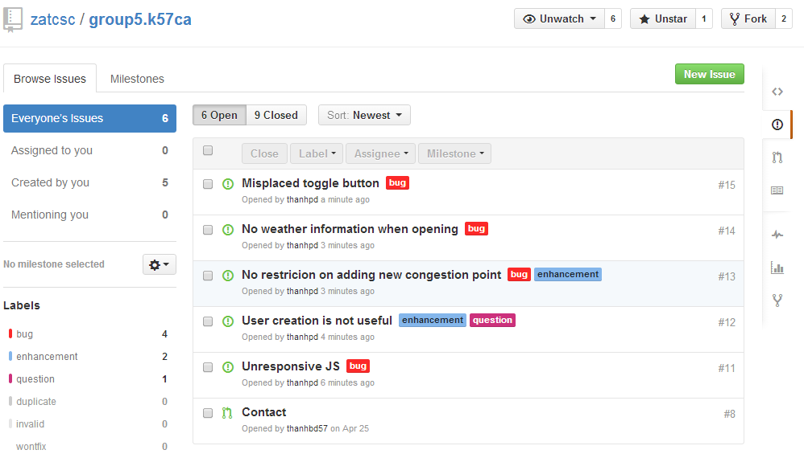
ISSUES MANAGEMENT

Slide 16
TEST: RSPEC
Please view in separate test reports that are included in the same folder of this presentation

Slide 17
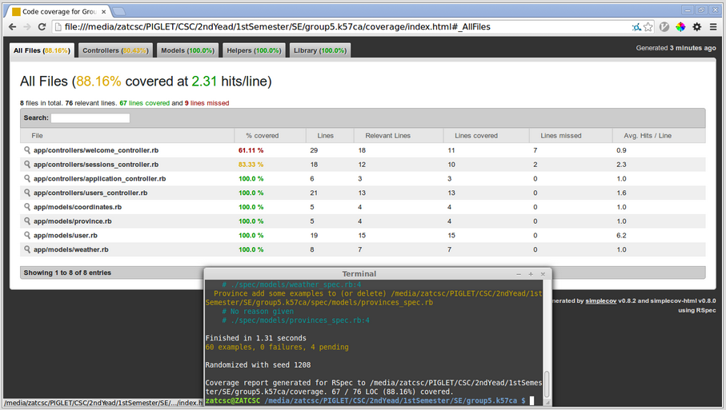
TEST COVERAGE

Slide 18
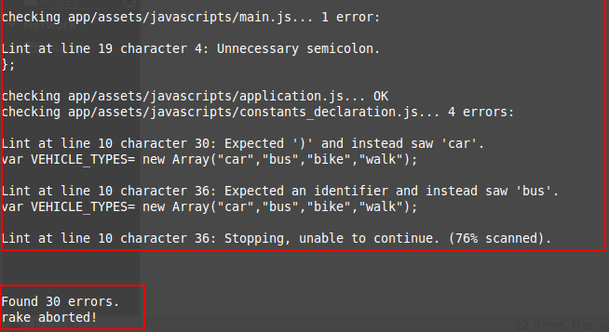
SOURCE CODE ANALYSIS
JSLint for JavaScipt
Errors

Slide 19
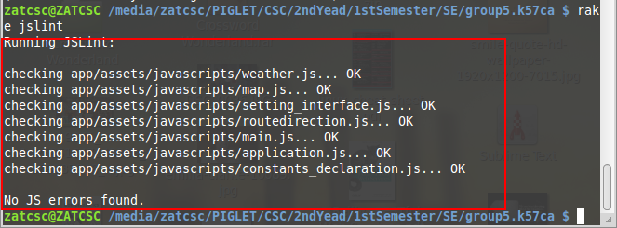
SOURCE CODE ANALYSIS
JSLint for JavaScipt
Fixed

Slide 20
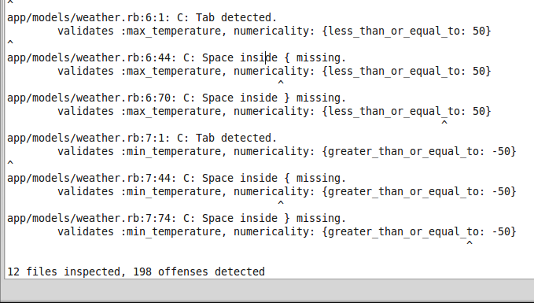
SOURCE CODE ANALYSIS
Rubocop for Ruby code
Errors

Slide 21
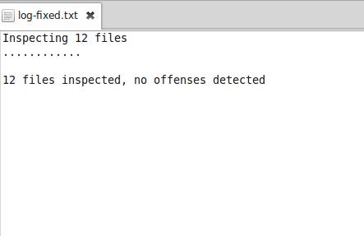
SOURCE CODE ANALYSIS
Rubocop for Ruby code
Fixed
See “Lint/...” in project folder for more details

Slide 22
Project Development Process
Week 1, 2:
+ Decide technical aspects of the project (What kind of project, programming language, framework, etc…)
+ Decide the schedule for weekly meeting
+ Collecting materials for studying
Week 3:
+ Setting up and testing Rails framework

Slide 23
Project Development Process
Week 4:
+ Implemented Google Maps API into the project
Week 5, 6:
+ Implemented Search API
+ Sample Test some files using Rspec
+ Finding code smell and refactor

Slide 24
Project Development Process
Week 7:
+ New feature: Best routing for users
+ Decided default language to be English
Week 8:
+ Refactor, changing project structure
+ Added test cases
+ New feature: User can create account to login

Slide 25
Project Development Process
Week 9:
+ New feature: User can contribute to the traffic congestion database & user can view weather information
Week 10:
+ Final editing, check bugs, test & release

Slide 26
DEMO
https://mega.co.nz/#F!dQAAyZhY!_e5mh8xERassCl3P7SDe1w

Slide 27
Q & A

